Slide 1
Tools of Design Thinking

Slide 2
Looking forward in the Session
Visualization
Journey mapping
Value chain analysis
Mind mapping
Rapid concept development
Assumption testing
Prototyping
Co-creation
Learning launches
Storytelling

Slide 3
Visualization
Visualization refers to any activity that takes information beyond text and numbers and into images, maps, and stories.
At its simplest level, visualization is about creating physical images and pictures and stepping away from our reliance as managers on numbers and text.
At a deeper level, it is about seeing with our mind’s eye: conjuring up mental images, vivid depictions of our ideas and insights about customers and their experiences, in a way that makes them human and compelling.

Slide 4
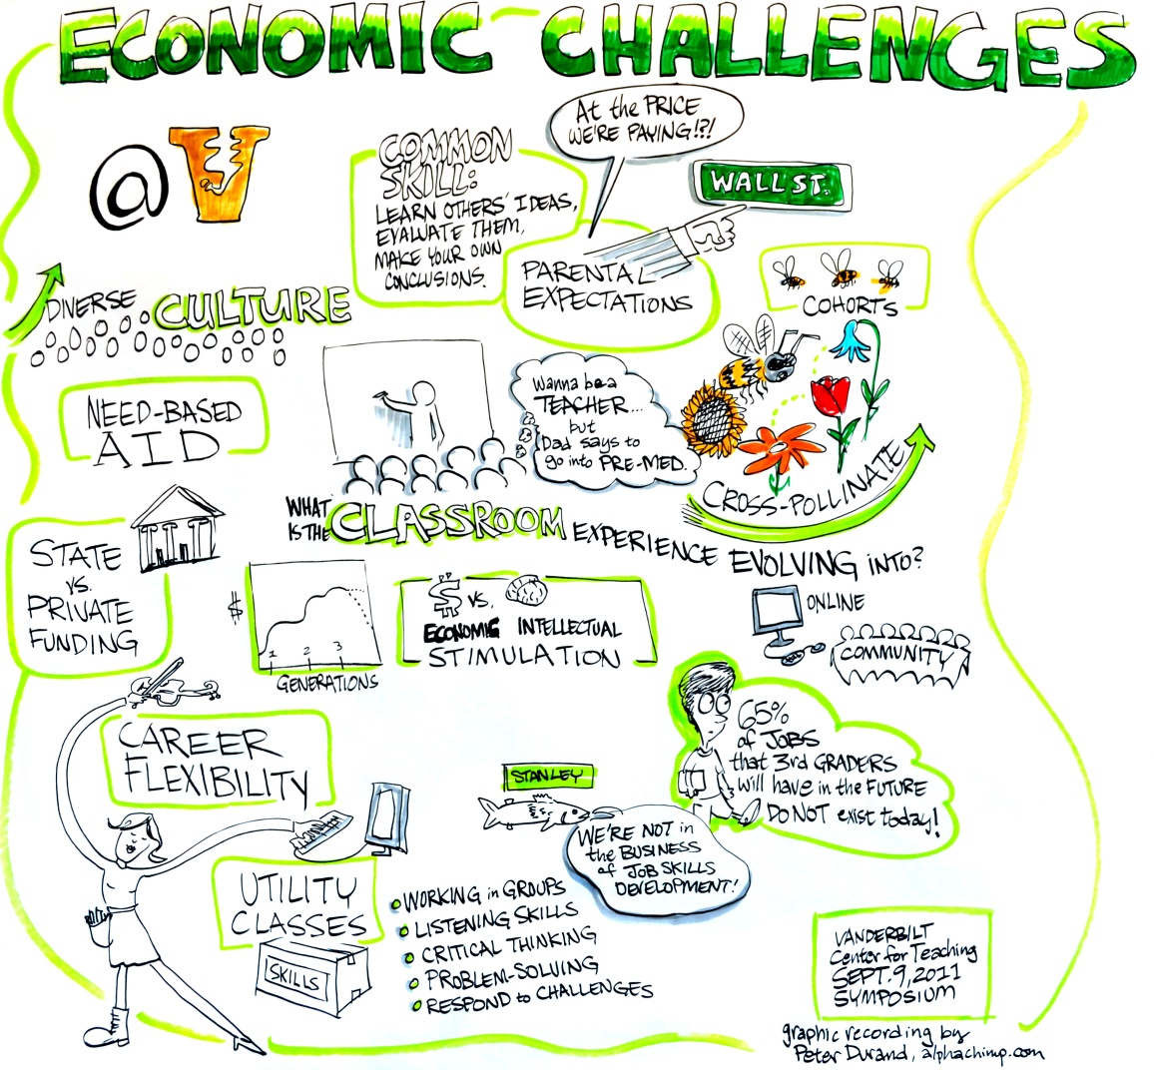
Visualization

Slide 5
Journey Mapping
Journey mapping (or experience mapping) is an ethnographic research method that focuses on tracing the customer’s “journey” as he or she interacts with an organization while in the process of receiving a service, with special attention to emotional highs and lows. Experience mapping is used with the objective of identifying needs that customers are often unable to articulate.

Slide 6
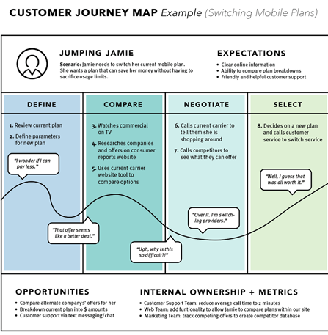
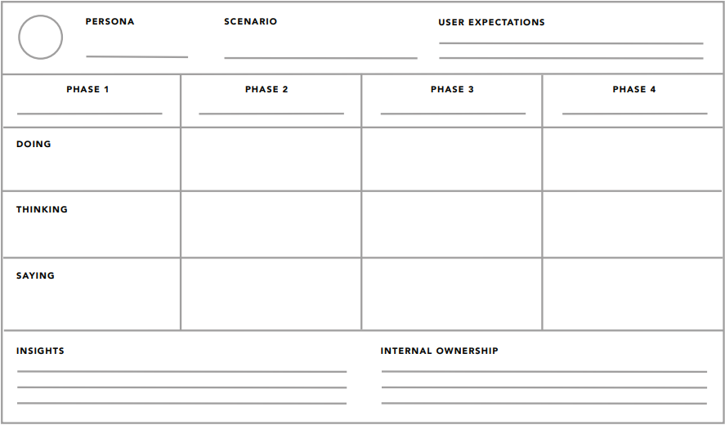
Journey Mapping
Customer Journey Map (Buying EV – Motorcycle)

Slide 7
Value Chain Analysis
Value chain analysis examines how an organization interacts with value chain partners to produce, market, and distribute new offerings. Analysis of the value chain offers ways to create better value for customers along the chain and uncovers important clues about partners’ capabilities and intentions.

Slide 8
Value Chain Analysis
Lakshmi is a software development manager for a software house. She and her team handle short software enhancements for many clients. As part of a team development day, they use Value Chain Analysis to think about how they can deliver excellent service to their clients.
During the Activity Analysis part of the session, they identify the following activities that create value for clients:
Order taking
Enhancement specification
Scheduling
Software development
Programmer testing
Secondary testing
Delivery
Support
Lakshmi also identifies the following non-client-facing activities as being important:
Recruitment: Choosing people who will work well with the team.
Training: Helping new team members become effective as quickly as possible, and helping team members learn about new software, techniques and technologies as they are developed.

Slide 9
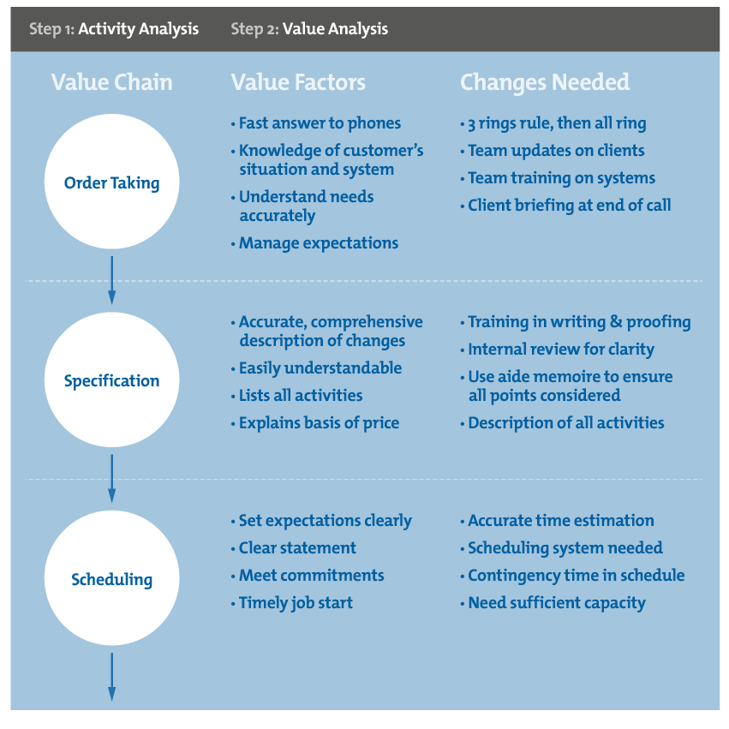
Value Chain Analysis
Next, she and her team focus on the Order Taking process, and identify the factors that will give the greatest value to customers as part of this process. They identify the following Value Factors:
Giving a quick answer to incoming phone calls.
Having a good knowledge of the customer's business, situation and system, so that they do not waste the customer's time with unnecessary explanation.
Asking all the right questions, and getting a full and accurate understanding of the customer's needs.
Explaining the development process to the customer and managing their expectations as to the likely timetable for delivery.
You can see these in the "Value Factors" column of figure 1.
They then look at what they need to do to deliver the maximum value to the customer. These things are shown in figure 1's "Changes Needed" column.
They then do the same for all other processes.
Once all brainstorming is complete, Lakshmi and her team may be able to identify quick wins, reject low yield or high cost options, and agree their priorities for implementation.

Slide 10
Mind Mapping
Mind mapping is used to represent how ideas or other items are linked to a central idea and to each other. Mind maps are used to generate, visualize, structure, and classify ideas to look for patterns and insights that provide key design criteria.

Slide 11
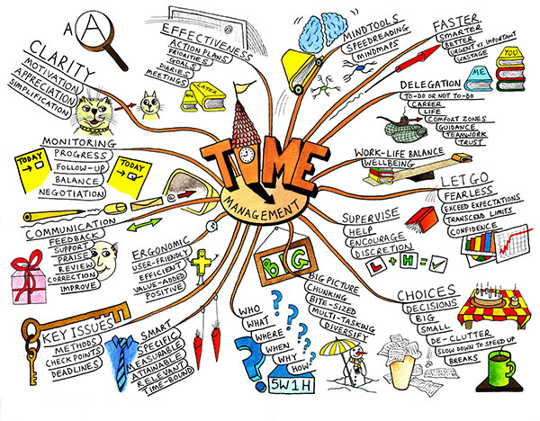
Mind Mapping

Slide 12
Mind Mapping
Road Traffic Management

Slide 13
Rapid Concept Development
Rapid concept development is a tool for using the insights and design criteria we have generated to develop new business opportunities. When people hear the term “innovation process,” concept development may be the only thing they think of, and they often equate it with brainstorming.

Slide 14
Assumption Testing
Assumption testing is a tool for bringing to the surface the key assumptions underlying the attractiveness of a new business concept and using available data to assess the likelihood that these assumptions are true. This approach acknowledges that any new business concept is actually a hypothesis—a well-informed guess about what customers desire and what they will value.

Slide 15
Assumption Testing
Improving Students Counselling Process

Slide 16
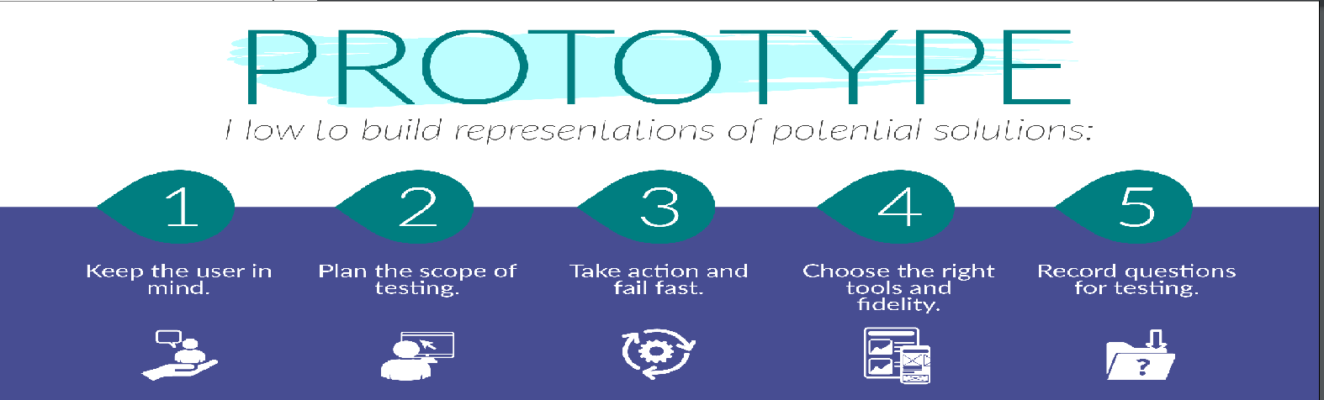
Prototyping
A prototype is a simple experimental model of a proposed solution used to test or validate ideas, design assumptions and other aspects of its conceptualization quickly and cheaply, so that the designer/s involved can make appropriate refinements or possible changes in direction.

Slide 17
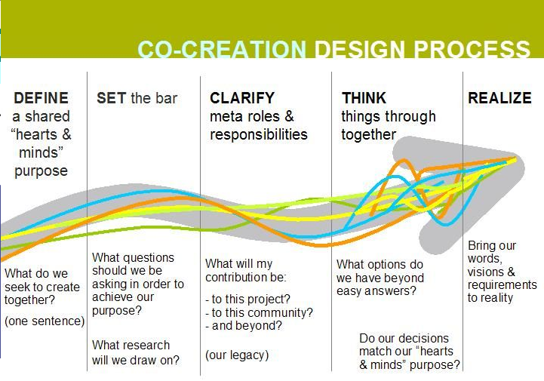
Co-creation
Co-creation is based on the belief that the users' presence is essential in the creative process, as the users provide insight into what is valuable to them. At its core, this means that co-creation is literally any process that brings together users and designers to work toward a shared goal.

Slide 18
Learning launches
Learning launches are designed to test the key underlying value-generating assumptions of a potential new-growth initiative in the marketplace. In contrast to a full new-product rollout, a learning launch is a learning experiment conducted quickly and inexpensively to gather market-driven data.

Slide 19
Storytelling
Storytelling is exactly how it sounds: weaving together a story rather than just making a series of points. It is a close relative of visualization—another way to make new ideas feel real and compelling. Visual storytelling is actually the most compelling type of story. All good presentations—whether analytical or design-oriented—tell a persuasive story.

Slide 20
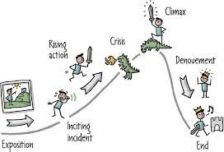
Storytelling
Story of Successful Product/ Service

